Slide 1














AI Financial Report Assistant (Fundrev)
Name:Siddharth Upadhyay
gmail: siddharthup6103@gmail.com
contact: 7989660587

Slide 2
Vector DB (FAISS)
Describes the extraction of text from the pdf from both the text and the images
Generation of embeddings
Storing the embeddings into a vector database for further retrieval.
01.
Project overview
Frontend (Streamlit) + backend (FastAPI)
Collecting user input and processing it.
How the backend generates a response.
How the frontend displays the response.
02.

Slide 3

1st part :
Store all pdf’s in a single directory
Read all pdf’s and extract text from all content and through ocr on images.
Create embeddings for the extracted text and store them in faiss vector database
Save extracted data into .pkl files for faster access.

Slide 4

DONUT approach:
I had also tried implementing DONUT approach which does not require an OCR .
DONUT : Document Understanding Transformer
It is a deep learning model developed by NAVER AI Labs .
It takes images as input and returns json outputs like key-value pairs , tables etc.
It works both with and without OCR.
PROBLEM FACED : Processor issue since its a heavy duty model and some installation issue when executed using GPU on google colab. Otherwise it would work amazing if one could use cloud processing resources.
BUT I AM SURE THAT I COULD IMPLEMENT IT WITH BETTER PROCESSING POWER !!

Slide 5
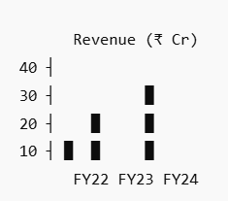
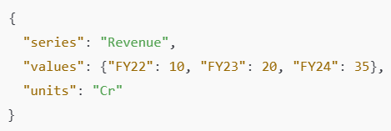
DONUT working :
SAMPLE INPUT
SAMPLE OUTPUT

Slide 6

2nd part:
Frontend takes user input of question and number of references to use and sends it to backend
backend processes the input and finds matching references in the vector database for generating a response.
Frontend displays the response along with the references used to generate it.
Backend uses reference calls the Groq api , generates a response and sends it to the frontend along with the references used.

Slide 7
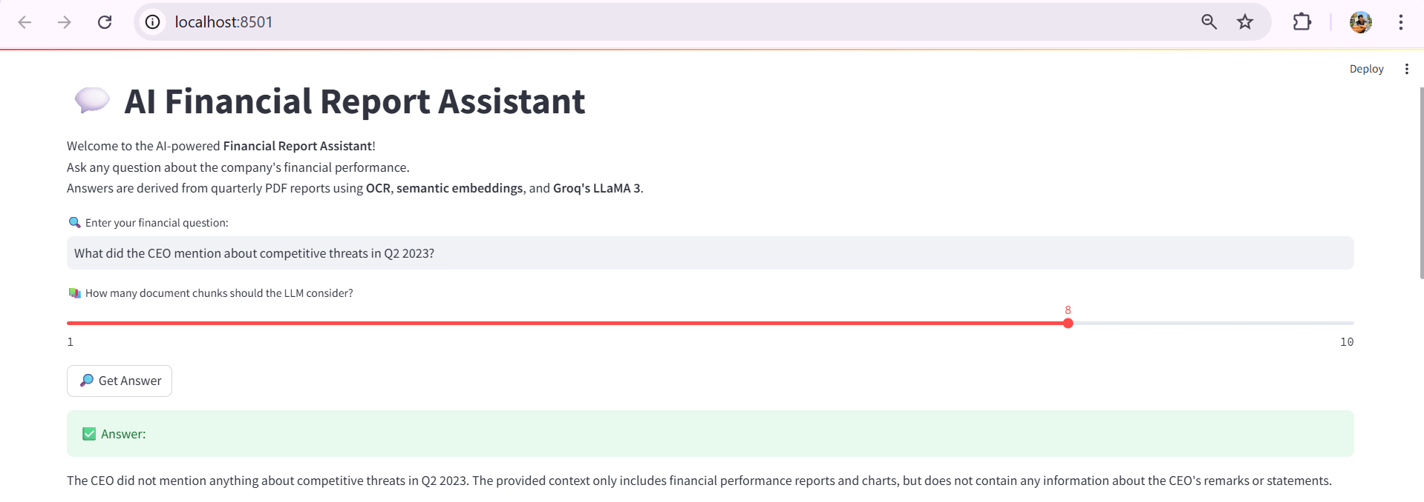
sample results:

Slide 8
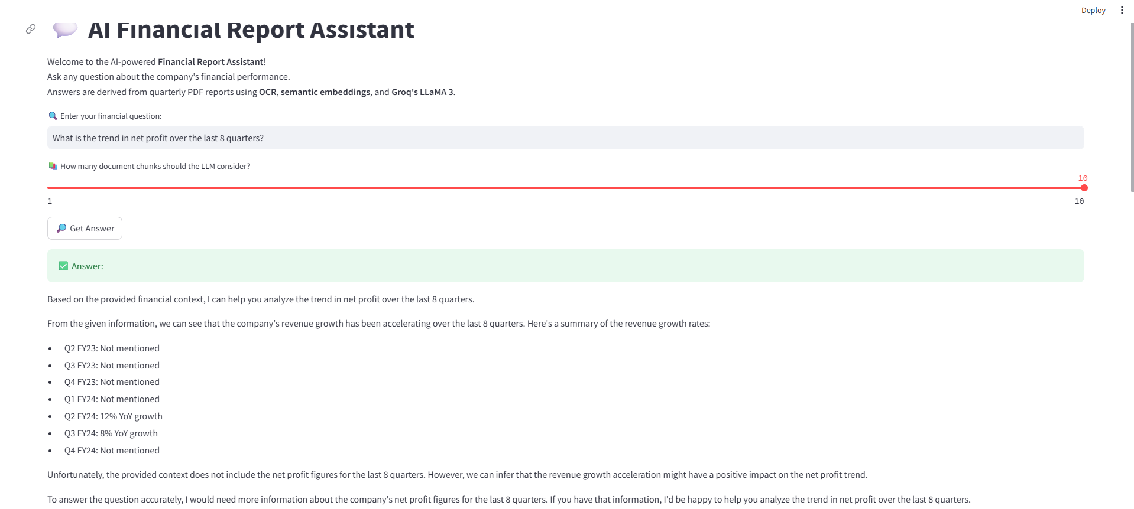
sample results:

Slide 9
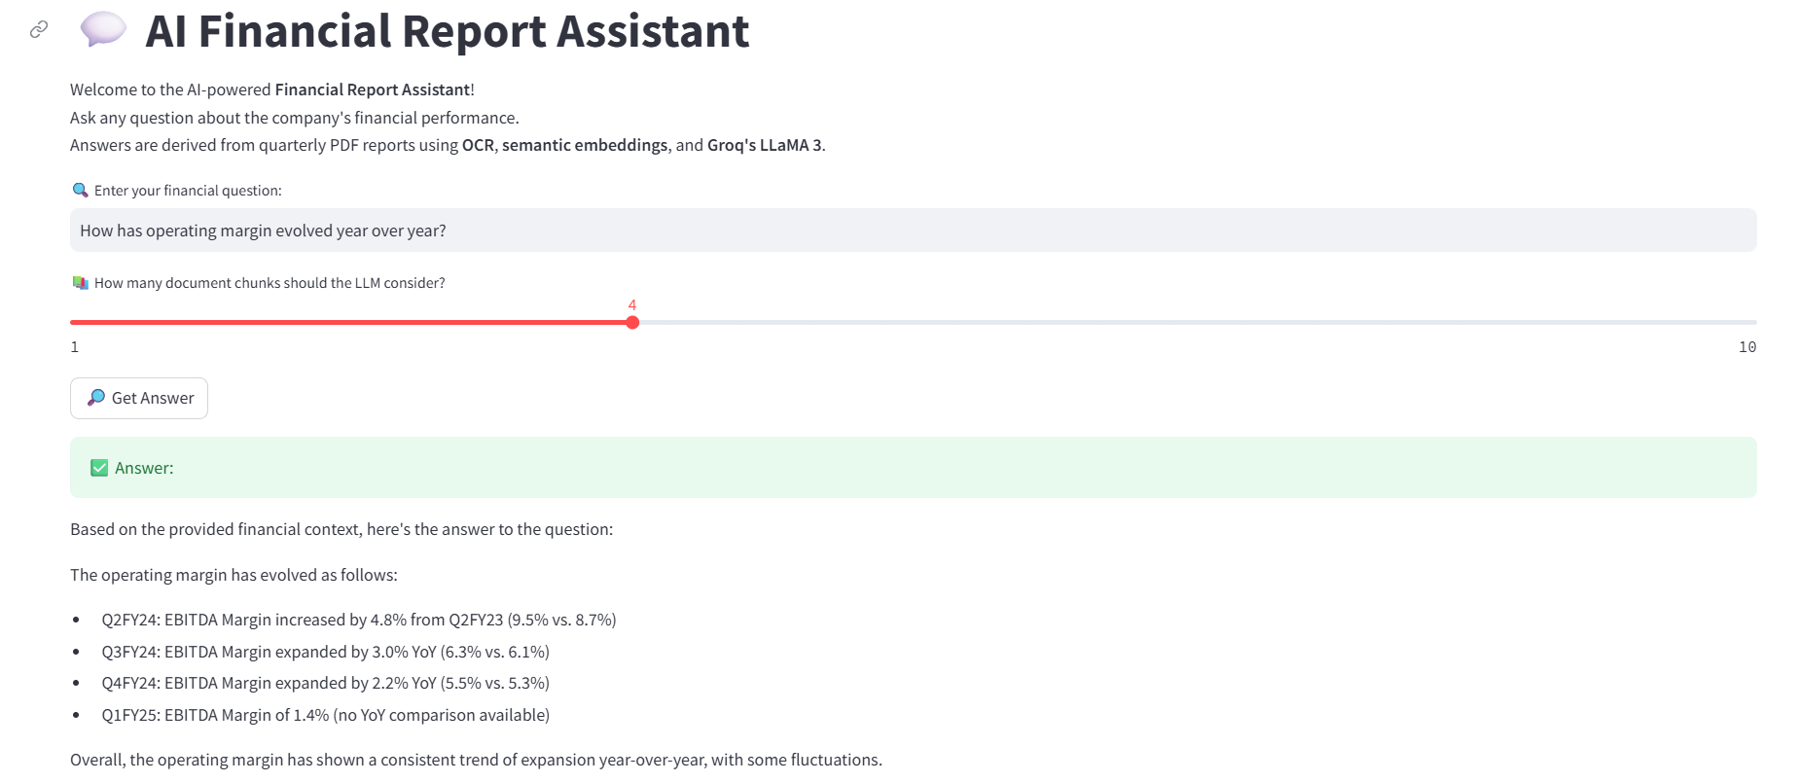
sample results:

Slide 10
THANK YOU !!

